Slide 1

Face Mask Detector using Machine Learning

Slide 2

Outline
Problem Statement
Motivation
Objectives
Proposed System Block Diagram
Software and Hardware Requirements
Implementation
Results
Challenges faced
Conclusion and Future Scope

Slide 3

Problem Statement
Creating Face Mask Detector using Machine Learning for classification between person wearing a mask and not wearing a mask.

Slide 4

Motivation
The trend of wearing face masks in public is rising due to the COVID- 19 all over the world.
Artificial Intelligence (AI) based on Machine learning and Deep Learning will facilitate to fight Covid-19 in many ways.
The process of monitoring large groups of individuals is becoming harder. The monitoring process involves the detection of anyone who is not wearing a face mask.

Slide 5

Objectives
Detecting a person and determining if he/she is wearing a face mask or not.

Slide 6
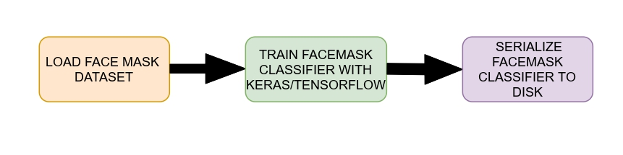
Proposed System Block Diagram (Phase 1)
Phase 1: Train Face Mask Detector

Slide 7
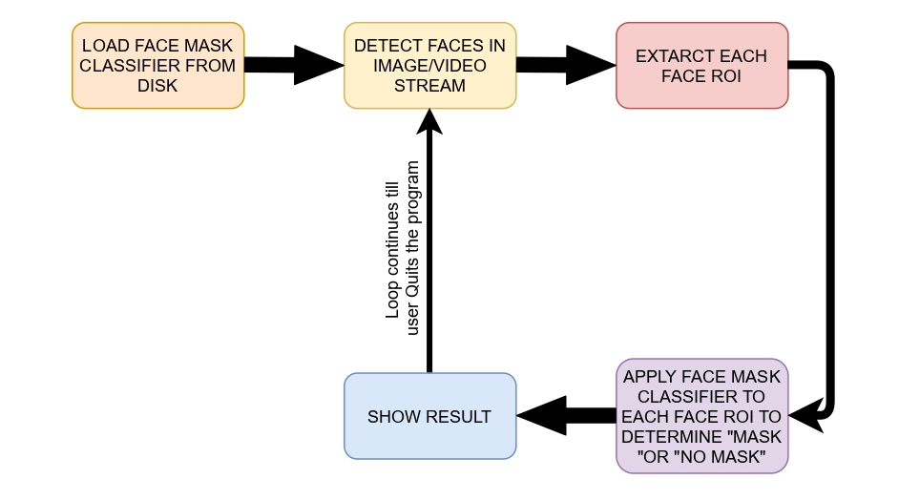
Proposed System Block Diagram (Phase 2)
Phase 2: Apply Face Mask Detector

Slide 8
Software and Hardware Requirements
Python
Python Libraries: Tensorflow, Keras, imutils, numpy, opencv-python, matplotlib, scipy, win10toast, imageio, pillow, winsound.
Windows 10
Advanced Installer Software
Camera Enabled Device

Slide 9
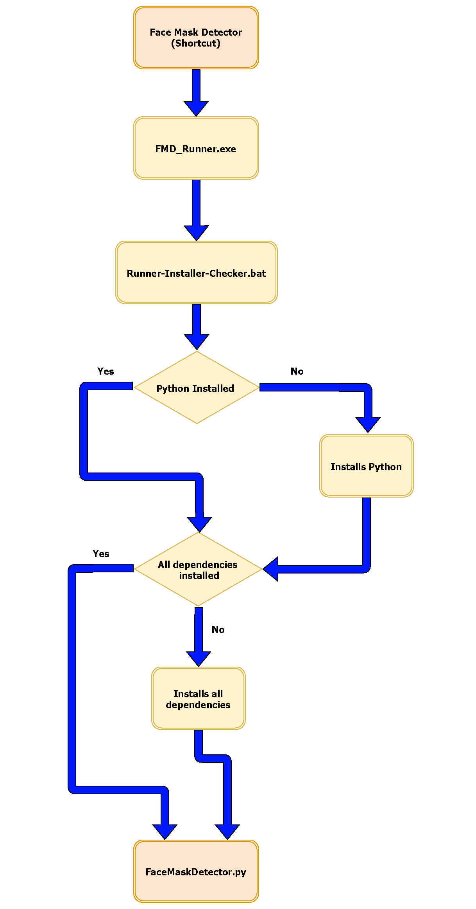
Implementation
Using Python and various Python libraries Face Mask Detector Software was made.
TensorFlow was used for Face Mask Detections.
After completing the setup the software launches FMD_Runner.exe
If Python is not installed then the Software installs python and proceeds to the installation of required dependencies.
If Python and all dependencies are already installed, then it executes FaceMaskDetector.py

Slide 10
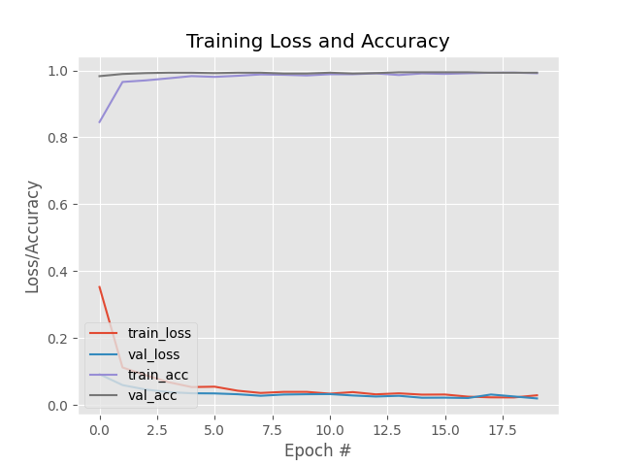
Result

Slide 11
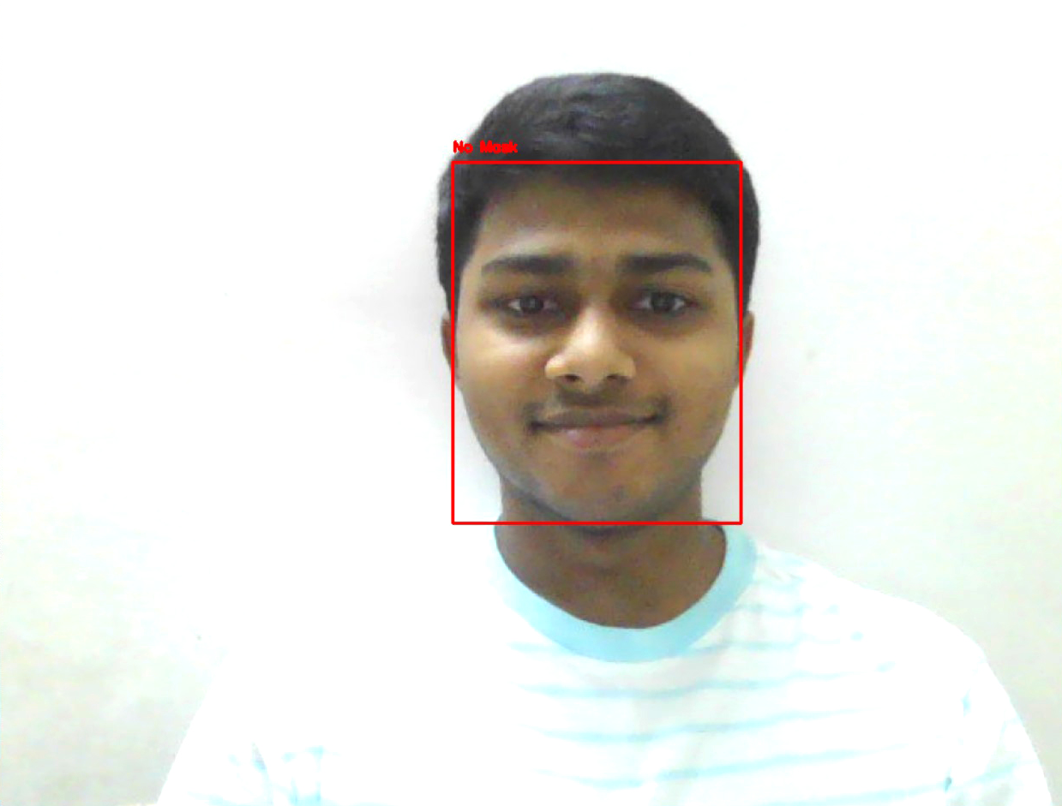
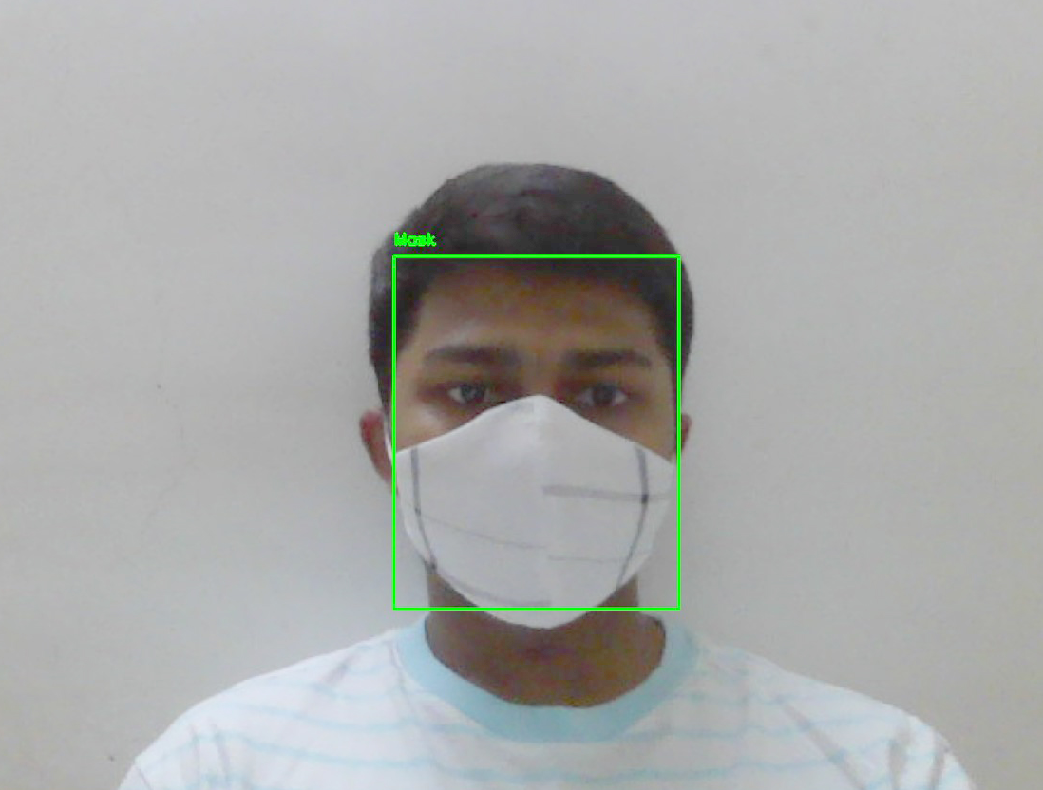
Result
Website : www.facemaskdetector.ml
No Mask
Mask

Slide 12

Challenges Faced
Python Interpreter and libraries must be installed for successfully running the software.
If Python is already not installed, then it will be installed by the software.
If all dependent files are not installed, then it will be installed on its own.
In few devices, ddl files missing errors occurred, in an automated way it was solved. If that particular file is not already there then it will be pasted there by the software.
Software deals with these issues on its own, so that user won't have to deal with internal techy issues.

Slide 13

Conclusion and Future Scope
Face mask detector detects and makes beep sound efficiently.
It can be used in many places to reduces Human Labour.
This software is a basic model with less features. Many more features can be added like Admin control panels, multiple camera supports in case of CCTVs, etc.
GUI based software can be made for better user experience.

Slide 14
Thank You
Presentation By:
K.Abhishek
Department of Computer Engineering

